Slide 1
Project Logo Guidelines & Applications

Slide 2
This manual contains the visual and conceptual process of CAIPIRINH₃A project identity. It presents the rules and guidelines on how to apply CAIPIRINH₃A logo in all media.
By following the provided materials it’s ensured the right use of the logo and supports the recognition of the company.

Slide 3
Project Concept
CAIPIRINH3A aims to address technical challenges hindering ammonia adoption as an alternative fuel by developing the innovative Plasma Mist Ammonia (PlasMi-NH3) burner—a plasma-enabled, self-learning combustor that efficiently burns liquid ammonia with ultra-low NOx emissions.
Key objectives include achieving thermal efficiency (~40%), ultra-low NOx emissions (≤7.5 g/kWh), faster ignition (>50% reduction in delay), and near-zero ammonia in exhaust (<10 ppm). Through testing at TRL4 and alignment with EU strategies (Fit for 55, Green Deal), the project promotes a shift from fossil fuels to carbon-free combustion, paving the way for climate neutrality by 2050 with significant environmental and socioeconomic impact.

Slide 4
CONTENTS
Name & Design
Colour Palette
Logo
Logo Variations
Fonts Used
Communication

Slide 5
NAME & DESIGN

Slide 6
Name & Design
Name: CAIPIRINH₃A
Meaning: combines the word Caipirinha, a famous cocktail, with NH3, the symbol for ammonia. It represents the project's innovative mix of technologies, like plasma-assisted combustion, to harness ammonia as a clean fuel. Just as Caipirinha blends ingredients, CAIPIRINH₃A blends advanced solutions for a sustainable, carbon-free energy future.
Design: The logo cocktail design symbolises the project’s unique fusion of advanced technologies and sustainability. The flame represents the transformative power of plasma-enabled combustion, kinetic models, and innovative injectors to efficiently ignite ammonia. The leaf signifies the commitment to clean energy and climate neutrality and the thunder reflects the innovative synergy of electrical energy and combustion for sustainable energy solutions.
Shape/Lines: A powerful combination or curved and strict lines showing a balanced approach, where innovative, forward-thinking solutions are built on a solid foundation of reliability and precision. This duality reflects the project's goal of combining cutting-edge technology with sustainable, effective results
Notes:
For objectives select slide 4 or slide 5

Slide 7
COLOUR PALETTE

Slide 8
COLOUR PALETTE
CAIPIRINH₃A Palette
The following colours should be used in all documents and communication materials in order to keep the identity
(4 main colours, black & white)
MAIN COLOURS
OTHER COLOURS
Deep Violet
RGB: 113 81 161
CMYK: 66 80 2 0
#7151A1
Fresh Green
RGB: 198 212 87
CMYK: 26 4 82 0
#c6d457
Black (Text)
RGB: 0 0 0
CMYK: 0 0 0 100
#000000
Ethanol Blue
RGB: 79 139 166
CMYK: 71 35 25 1
#4f8ba6
Mist Silver
RGB: 209 221 229
CMYK: 17 7 6 0
#d1dde5
White
RGB: 255 255 255
CMYK: 0 0 0 0
#FFFFFF

Slide 9
COLOUR PALETTE
Colours Definition
Each colour represents the CAIPIRINH₃A project and completes its goal.
DEEP VIOLET
Symbolises harmony, fusion of plasma, power, creativity, and forward-thinking.
FRESH GREEN
Symbolises sustainability, clean & green future, eco-friendly, green fuel alternative, calm, giving hope.
ETHANOL BLUE
Symbolises adaptability of the project’s approach, signifies trust, stability, and progress.
MIST SILVER
Represents plasma technologies, futuristic engineering, mysterious aura.

Slide 10
LOGO

Slide 11

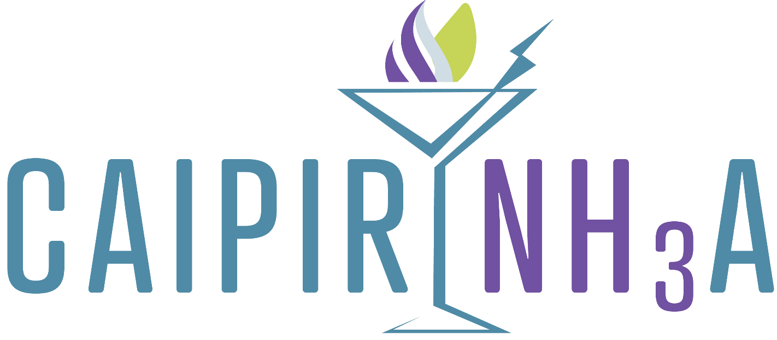
LOGO
The CAIPIRINH₃A Project Logo
The following formations of logo are given to be used for print and applications where all elements are clearly visible in order not to lose the project’s identity.
CAIPIRINH₃A Logo full colour
CAIPIRINH₃A Logo full colour icon

Slide 12
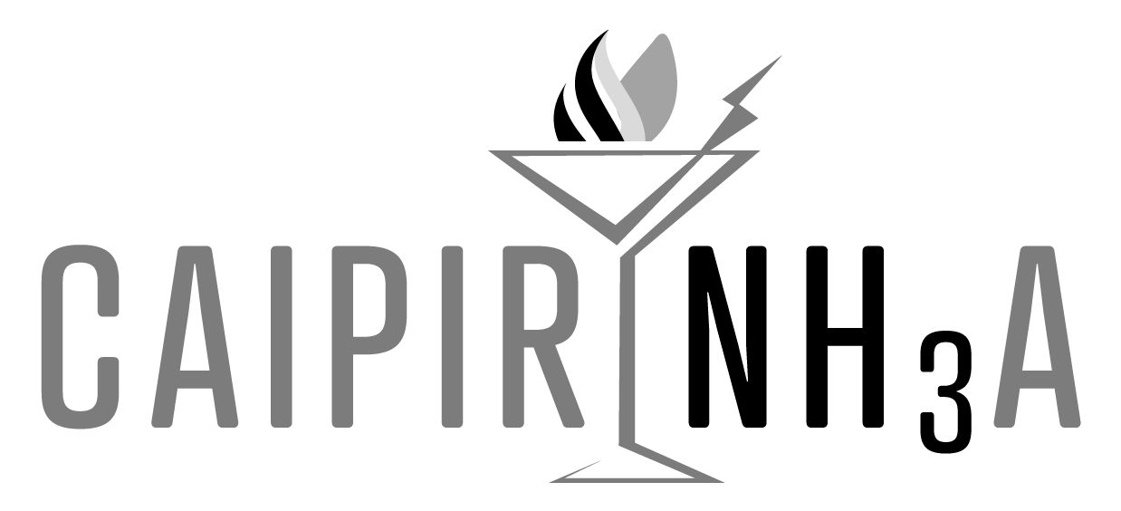


LOGO
CAIPIRINH₃A Project Logo Color Variation

Slide 13

LOGO
Safety Margins
The safety margins aim to preserve the appropriate visibility of the logo. Height X is the minimum space applied to all versions of the materials in order to protect the logo’s visibility and placement of other elements around it.
X=Logo Text Height
X
X/2
X
X
X
X

Slide 14
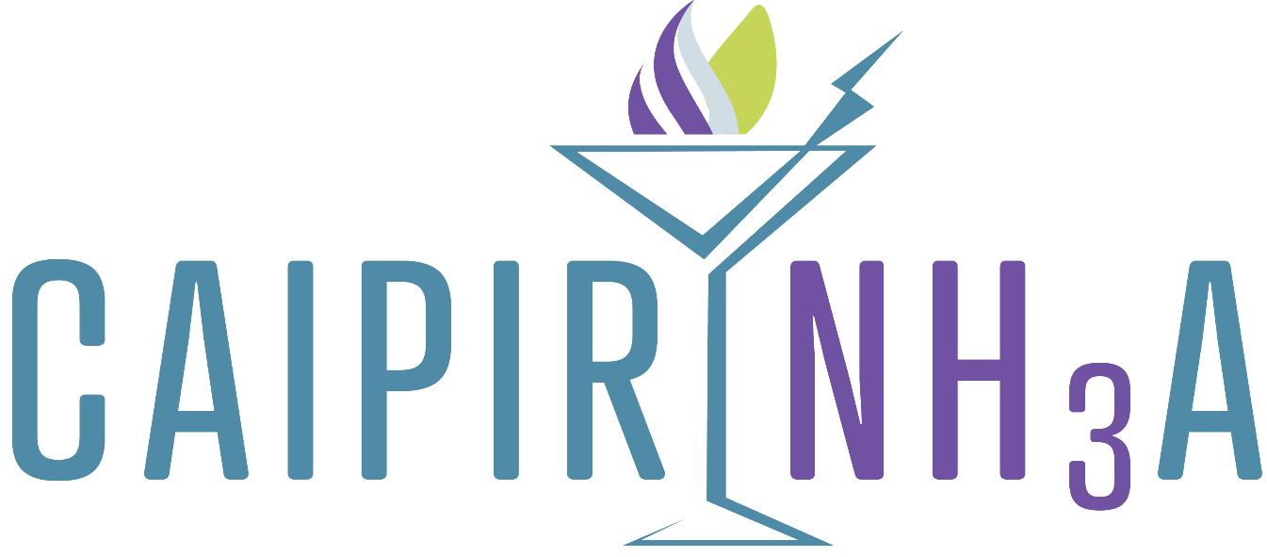
LOGO
Minimum Dimensions
The measurements below set the minimum size of the logo that can be applied in digital or printed materials. The same dimensions apply to all logo variations.
12mm
23mm
Minimum Height: 12mm
Minimum Width: 23mm

Slide 15
LOGO VARIATIONS

Slide 16

LOGO VARIATIONS
The following variations are all valid uses of the CAIPIRINH₃A palette

Slide 17

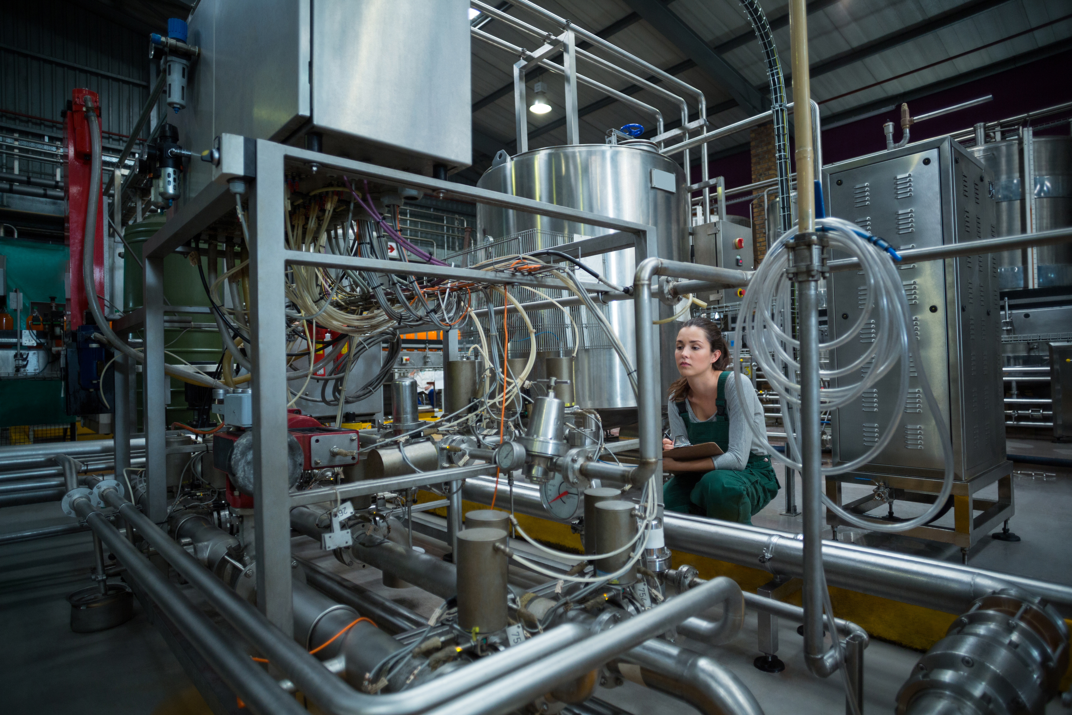



LOGO VARIATIONS
Avoid putting the logo on difficult to read background, pattern, put shadow, stretch, outline, change colour or rotate it.

Slide 18
FONTS USED

Slide 19
FONTS USED
Font Name | Description
Montserrat ExtraBold | Used for section titles, descriptions for super titles, paragraph headers, presentation titles, letterheads and other collateral such as card details and other general uses.
Montserrat | Used for main text to emphasise on details, banner script, can be used for main body in D&C materials etc.
Calibri Italic | Only for quotes, testimonials or similar uses.
Calibri Regular | For text, details, banner messages, main running text in brochures (to be convenient to all)
Calibri Bold | Used for strong text, emphasise or important text etc.

Slide 20
COMMUNICATION

Slide 21
COMMUNICATION
Communication Messages
The project identity in one sentence
Combustion of liquid ammonia, assisted by plasma discharges, as a novel and clean energy conversion method
Project’s Goal
CAIPIRINH₃A will pave the way for a disruptive solution, which is eminent and urgent, towards the re-orientation of the energy conversion sector from fossil fuel-based to carbon free-based combustion systems and the ultimate goal of climate-neutral Europe by 2050.

Slide 22
NAME: Ioanna Katsavou
ENTITY: EXELISIS
CONTACT INFO: ioanna.k@exelisis.gr

